Slide 1

IBM MQ Upgrade Best Practices
John Carr – Senior Consultant for TxMQ
Work Smart with IBM MQ!

Slide 2
Presentation Overview
Presentation Based on Experience
  Migrating from MQ v7.x to v9.x LTS on distributed in several places
  We’ll cover the best practices we employed along the way
Presentation Main Section
  Basic Considerations
  Cross-Section of MQ v9 in Production for On-Prem
Odds and Ends
  Compatibility (Cipher specs, JREs)
  Walk Through a simple “Lift and Shift” migration

Slide 3
Basic Considerations

Slide 4
CD vs LTS
Long Term Support (LTS)
  Demands the highest levels of stability
  Releases approximately every two years
  Release is supported for at least five years
Continuous Delivery (CD)
  Intended for customers wanting to explore the latest features
  Released every few months

Slide 5
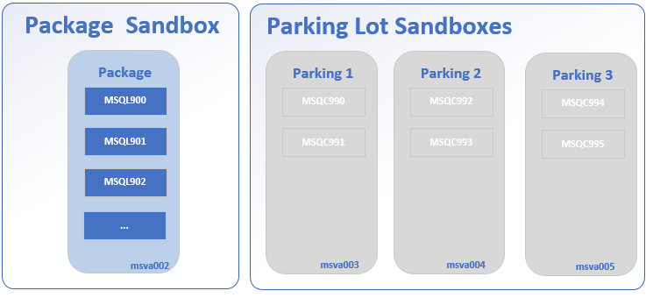
CD vs LTS
  - In addition to LTS, setup three virtual servers and put into a “parking lot” to reserve to explore CD features, if necessary.

Slide 6
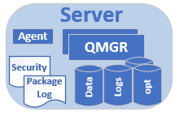
In-Place Install vs. Side by Side
vs. “Fresh Install”
The suggestion? “Fresh Install”
  This was chosen most often because it’s a good idea to get server refreshes every few years.
  Requires extra work and more help from other operations teams, but it’s always good because it gave the opportunity to “clean house” with the QMGRs

Slide 7
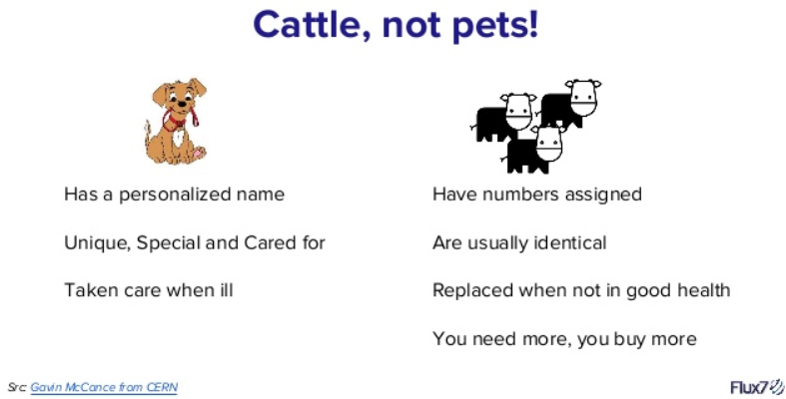
Naming Standards
  Regardless of your MQ network size, it’s best to treat them like cattle, not pets. This includes QMGR and Object names.

Slide 8
Always remember the basics for standards
  Server Naming
  QMgr Naming
    QMgr Range Numbering
    Port Range Numbering
  Environment Designations
  Virtual or Physical Servers
    You may not be ready for containers or the cloud
  Etc.

Slide 9
Cross-Section of MQ v9
in Production Setting
Reference Implementation
(on-prem)

Slide 10
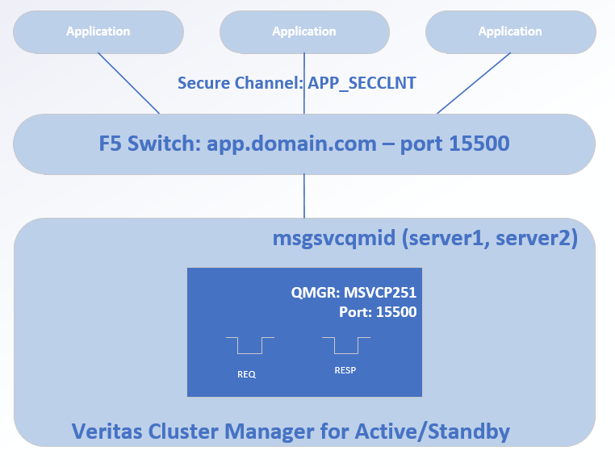
Messaging Service in a Nutshell
Applications use a secure channel to connect to QMGR
LDAP Authorization/Authentication (cover more soon)
Apps connect to F5
Veritas used as HA (active/standby)
Effort was to hide details about true QMGR location

Slide 11
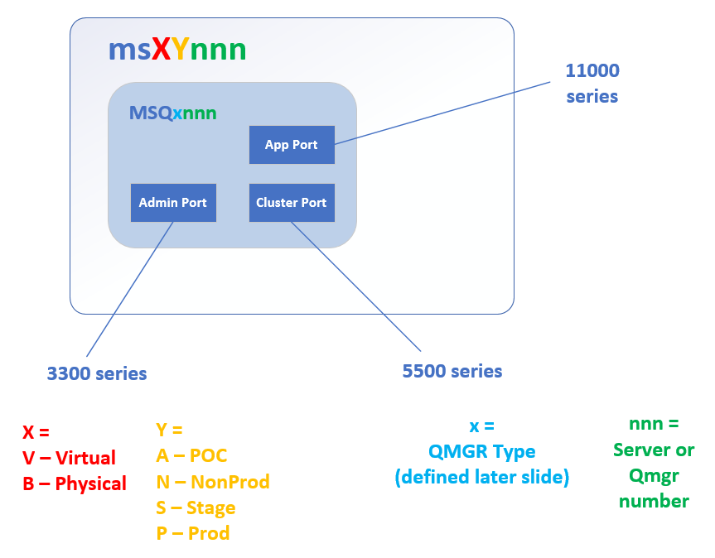
QMGR Listener Ports
Followed a strategy where three ports would be employed
  Application Port
    Application traffic
    Shared environment still used a single listener port for app traffic
  Cluster Port
    MQ Cluster Traffic
  Admin Port
    Internal use (if needed)

Slide 12
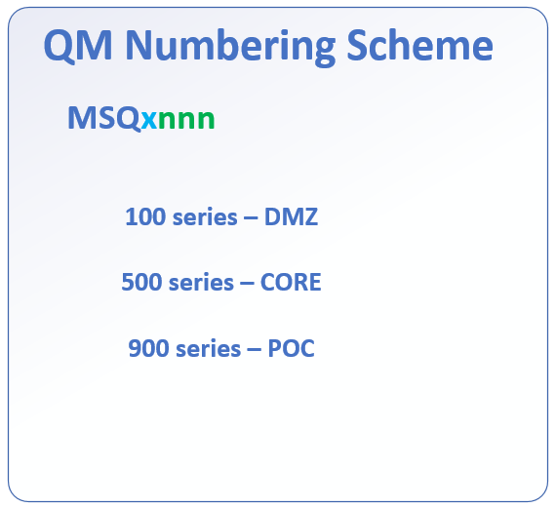
QMGR Organization
Follow a strategy for numbering your QMGRs.
It helps to follow a range meant for different operational domains: CORE, DMZ, POC
Especially for LDAP
  Most shops have at least two LDAP servers
    DMZ
    CORE
  Different LDAP operational domains will drive a different setup for AUTHINFO and AUTHRECS

Slide 13
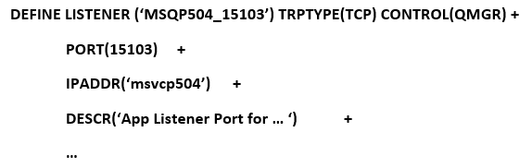
QMGR Listener Ports
Cattle, not Pets!
  Come up with a strategy where your MQ Objects for LISTENERs, CHANNELs, or where it makes sense to give a “branding name” that uniquely identifies the object
<QMGR>_<PORT>
Don’t forget a useful DESCR – Really!!

Slide 14
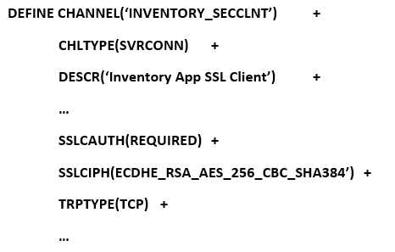
CHANNELS
Each App has it’s own CHANNEL to connect
Don’t let Apps share CHANNELs, especially when dealing with SSLCIPHs
Don’t forget a DESCR
<APPNAME>_SECCLNT

Slide 15
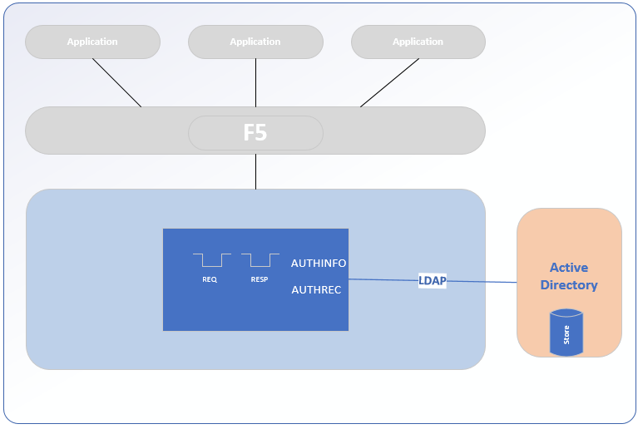
Authorization and Authentication
Authentication
  AUTHINFO
  Definitions used to connect to an LDAP Server
Authorization
  AUTHREC
  Definitions for what user/group can have access to which MQ Objects
Most shops will have at least two LDAP/AD servers
  CORE
  DMZ

Slide 16
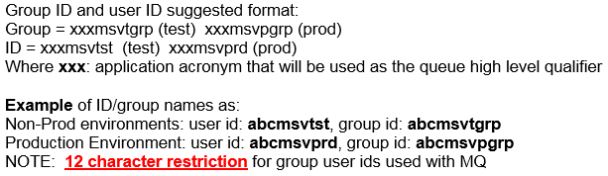
Active Directory (AD)
Define a Windows Global group access specifically for use with MQ
  Ideally, create two groups: NON-PROD and PROD
Define a windows application id and associate it with the group
  Ideally, create two IDs: NON-PROD and PROD
Provide the id/group information to MQ admin for authorization
  MQ admins could use ldapsearch on the userID from command line and inspect the results
NOTE: When accessing a MQ v9 queue manager the defined windows application id does not need login rights to the hosting MQ server

Slide 17
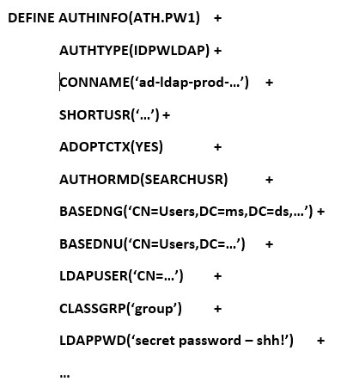
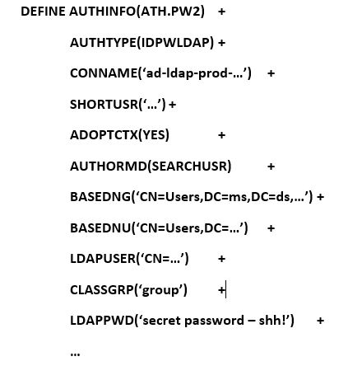
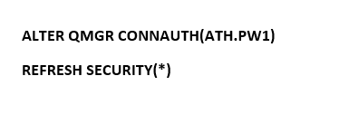
AUTHINFO
Create two AUTHINFO objects
Assign one to QMGR CONNAUTH
Passwords change often – 60 to 90 days
Good practice to do this because you can schedule better password changes with a second AUTHINFO
Less service interruption

Slide 18
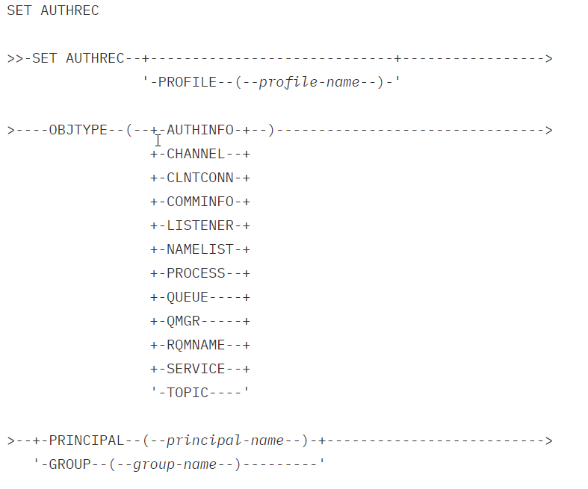
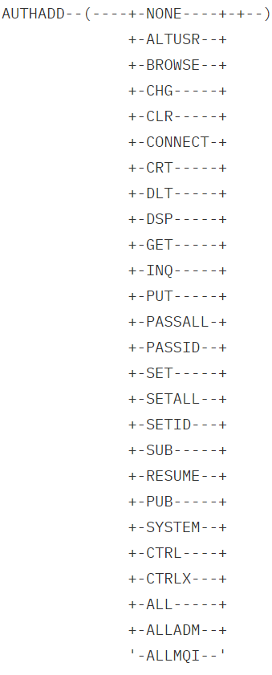
AUTHREC
Fine Grain vs Coarse Gran Access
Fine Grain
  Specific access – only what’s needed by the app
  GET or PUT only for UserID
Coarse Grain
  Cast a wide net for access to a group of objects
  All queues beginning with APP1.** get ALLMQI for UserGroup
Combinations thereof…

Slide 19
Use a common sense approach to security
  Give an application authorization for only what it needs
  What is the application’s purpose?
For Example: a business app needs
  Connect to a QMGR
  GET messages from queues starting with APP.IN.*
  BROWSE messages from another app’s local queue called APP2.AUDIT.QUEUE
  PUT messages to queue called APP.APP2.PO.QUEUE
  PUBlish to a TOPIC Object APP_TOPIC
  Be a SUBscriber or RESUME a subscription to another TOPIC Object called APP_TOPIC2
The more you know about an app using a QMGR, the better you can grant only the necessary access
AUTHREC

Slide 20
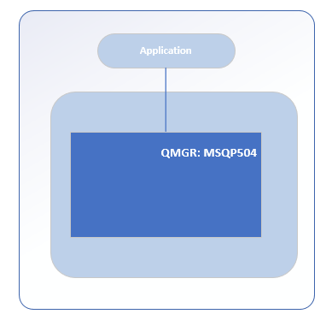
AUTHREC: Connect to QMGR
A business app’s needs
  Connect to a QMGR
Use a PROFILE and give the object name is the QMGR name
Use the AD User Group when granting access
SET AUTHREC PROFILE(MSQP504) OBJTYPE(QMGR) GROUP(‘CN=appgrp’) AUTHADD(INQ,CONNECT)

Slide 21
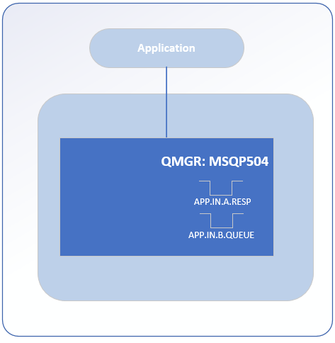
AUTHREC: GET Message from Queue
A business app’s needs
  GET messages from queues starting with APP.IN.*
Use a PROFILE and give APP.IN.** as it’s name
Meant for LOCAL queues
BEST PRACTICE
  Use wildcards (*) only for queues meant as input to a specific app
SET AUTHREC PROFILE(APP.IN.**) OBJTYPE(QUEUE) GROUP(‘CN=appgrp’) AUTHADD(INQ,GET)

Slide 22
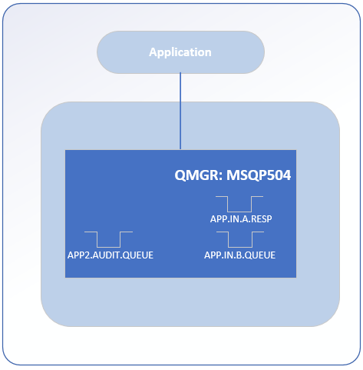
AUTHREC: BROWSE a Queue
A business app’s needs
  BROWSE messages from another app’s local queue called APP2.AUDIT.QUEUE
Use a PROFILE and give the actual queue object as it’s name
Meant for LOCAL queues
BEST PRACTICE
  Be specific when granting and NOT use wild cards (*) when browsing another app’s queue
SET AUTHREC PROFILE(APP2.AUDIT.QUEUE) OBJTYPE(QUEUE) GROUP(‘CN=appgrp’) AUTHADD(INQ,BROWSE)

Slide 23
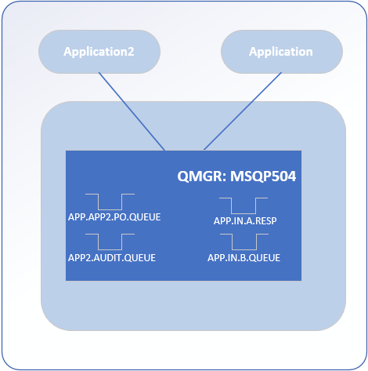
AUTHREC: PUT to a Queue
A business app’s needs
  PUT messages to queue called APP.APP2.PO.QUEUE
Use a PROFILE and give the actual queue object as it’s name
Meant for LOCAL, REMOTE and clustered queues
BEST PRACTICE
  Be specific when granting and NOT use wild cards (*) because…
SET AUTHREC PROFILE(APP.APP2.PURCHASE.ORDER.QUEUE) OBJTYPE(QUEUE) GROUP(‘CN=appgrp’) AUTHADD(PUT)

Slide 24
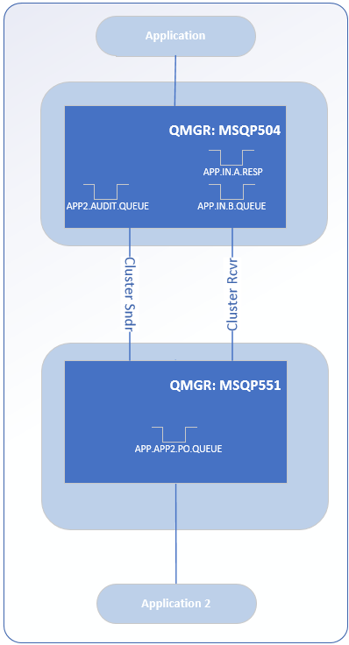
AUTHREC: PUT to a Queue
Because…
  You may need to move app2 to another QMGR someday and use a cluster queue
  When Specific with the AUTHREC PUT permissions, then you don’t need to change
If App1 wants to put a message to a queue, it really shouldn’t have to know the location of that queue

Slide 25
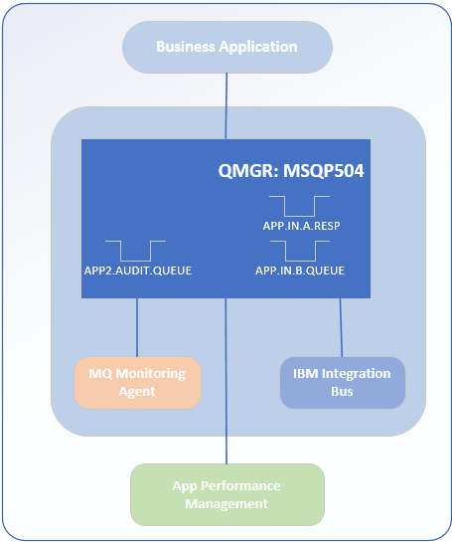
Other Considerations
BEST PRACTICE
  Start thinking about anything connecting to a queue manager as an application
  Don’t let apps run as the MQ owner (mqm)
Application Types
  Business App
  ACE or IIB
  MQ Monitoring Agent
  App Performance Mgt Product
They’ll need to have AUTHRECs set for them, too
Doing this, you’ll have a healthy, happy MQ ecosystem ☺

Slide 26
Compatibility

Slide 27
SSL Cipher Spec and Cipher Suites for TLS 1.2
WebSphere Application Server 7.x and 8.5
  Where MQ Resource Adaptor Level at 7.0 or 7.5
    CipherSpec on MQ CHANNEL - TLS_RSA_WITH_AES_256_CBC_SHA256
    CipherSuite on WAS - SSL_RSA_WITH_AES_256_CBC_SHA256
  Where MQ Resource Adaptor Level at 8.0
    CipherSpec on MQ CHANNEL - ECDHE_RSA_AES_256_CBC_SHA384
    CipherSuite on WAS - SSL_ECDHE_RSA_WITH_AES_256_CBC_SHA384
NOTE: App teams using WAS 7.x/8.5 are encouraged to upgrade to WAS 9
WebSphere Application Server 9
  Where MQ Resource Adaptor Level at 8.0 or 9.0
    CipherSpec on MQ CHANNEL - ECDHE_RSA_AES_256_CBC_SHA384
    CipherSuite on WAS - SSL_ECDHE_RSA_WITH_AES_256_CBC_SHA384
NOTE: MQ 9.0 resource adapter bundled with WAS 9

Slide 28
SSL Cipher Spec and Cipher Suites for TLS 1.2
Standalone Java
  Where MQ Java Client Library at 7.0 or 7.5
    CipherSpec on MQ CHANNEL - TLS_RSA_WITH_AES_256_CBC_SHA256
    CipherSuite on Oracle JRE - TLS_RSA_WITH_AES_256_CBC_SHA256
  Where MQ Java Client Library at 8.0 or 9.0
    CipherSpec on MQ CHANNEL - ECDHE_RSA_AES_256_CBC_SHA384
    CipherSuite on Oracle JRE - TLS_ECDHE_RSA_WITH_AES_256_CBC_SHA384
Other Details
  Ensure the IBM or Oracle JRE is at v7 or v8 with appropriate fix packs
  In surprise, this was the biggest “gotcha” we encountered
  https://www.ibm.com/software/reports/compatibility/clarity-reports/report/html/softwareReqsForProduct

Slide 29
Simple Migration Activity

Slide 30
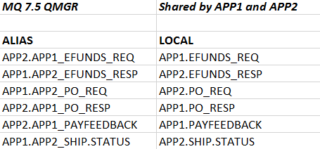
Queue Manager Object Inventory for App
APP1 and APP2 are shared on the same QMGR
APP1 team is ready to migrate to MQ v9, but APP2 team won’t be ready till 2020.
Take an MQ Object inventory of all queues and topics used by APP1 and review with the app team
It’s your opportunity to remove un-used queues or topics

Slide 31
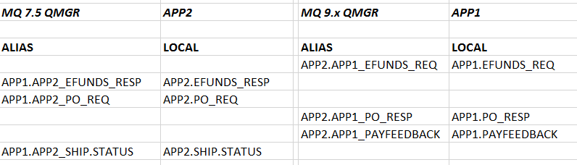
Migrate Queues
  Set AUTHREC to PUT (APP2)
    APP2.APP1_EFUNDS_REQ
    APP2.APP1_PO_RESP
    APP2.APP1_PAYFEEDBACK
  Set AUTHREC to PUT (APP1)
    APP1.APP2_EFUNDS_RESP
    APP1.APP2_PO_REQ
    APP1.APP1_SHIP.STATUS

Slide 32
Migrate Queues
  Set AUTHREC to GET (APP2)
    APP2.EFUNDS_RESP
    APP2.PO_REQ
    APP2.SHIP.STATUS
  Set AUTHREC to GET (APP1)
    APP1.EFUNDS_REQ
    APP1.PO_RESP
    APP1.PAYFEEDBACK

Slide 33
Migrate Queues

Slide 34

Questions & Answers

Slide 35
John Carr – Senior Consultant for TxMQ
Work Smart with IBM MQ!

